Slide 1
Financial Analytics Data Analysis
Unveiling Competitive Insights

Slide 2
Table of contents
01
02
03
04
Introduction
Analytical Exploration
Understanding the Competitive Landscape
Analytical Exploration of Top 500 Companies in India
Insights
Conclusion
Strategic Insights and Decision Support
Conclusion of the project outcome

Slide 3
01
Introduction
Understanding the Competitive Landscape

Slide 4
01 Navigating Business Competition
In the ever-evolving landscape of business, the ability to navigate and thrive in a competitive environment is paramount for sustained success. Without a profound understanding of the competition, businesses face the risk of stagnation or even failure. This analysis aims to delve into the dynamics of competition within the Indian corporate landscape, focusing on the market capitalization of the top 500 companies.

Slide 5
Holistic Perspective
This analysis assumes a holistic perspective, acknowledging the diversity and complexity inherent in the top 500 companies. Through a judicious combination of statistical measures, visualizations, and interpretative findings, we aim to deliver a compelling narrative that not only addresses the immediate requirements of the problem statement but also acts as a catalyst for continued exploration and refinement.

Slide 6
02
Analytical Exploration
Analytical Exploration of Top 500 Companies in India

Slide 7
02 Data Loading and Overview
The analysis begins by loading the dataset from the 'Financial Analytics data.csv' file. The initial exploration provides an overview of the dataset, allowing us to understand its structure and content.
Handling Missing Values
Mean Metrics Calculation
Scatter Plot: Market Cap vs. Quarterly Sales

Slide 8
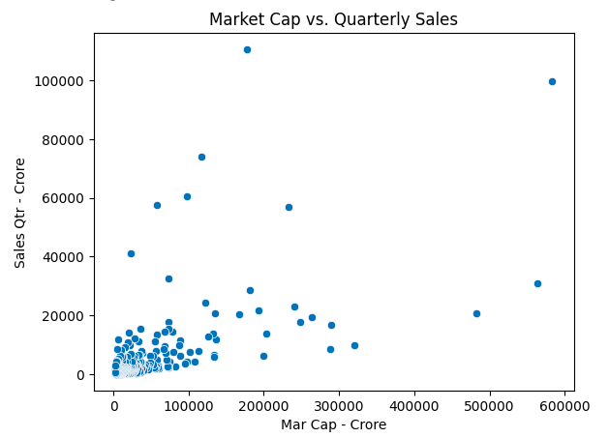
Scatter Plot: Market Cap vs. Quarterly Sales

Slide 9
03
Insights
Strategic Insights and Decision Support

Slide 10
03 Correlation Analysis
Correlation Analysis
The correlation between market capitalization and quarterly sales is quantified and presented, providing insights into the strength and direction of this relationship.
The analysis includes the identification and display of the top N companies based on market capitalization. This information is valuable for understanding the market leaders.

Slide 11
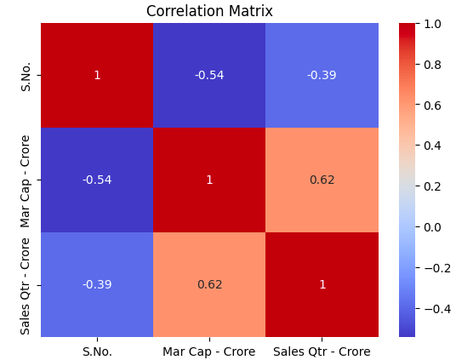
Correlation Matrix

Slide 12
04
Conclusion

Slide 13
04 Conclusion
This competition analysis offers valuable insights into the top 500 companies in India, focusing on market capitalization and quarterly sales.
The calculated metrics, visualizations, and correlation analysis provide a comprehensive understanding of the dataset. Further exploration and in-depth analyses can be conducted based on these initial findings to support management decisions and enhance business results.

Slide 14
Thank You

